Slide 1
NLP Final Project
Rachel Lui Win Tan
20 November 2019

Slide 2
Sentiment Analysis of Brexit tweets - DATA
Training Data – Twitter Sentiment Analysis Dataset (Kaggle Competition)
99989 tweets that have been labelled with positive (1) and negative (0) sentiment
10,000 tweet sample used as training dataset
Target Data – Brexit Opinion Data by Kaggle user Oscar Dossa
1,512,728 tweets containing #Brexit, dated from gathered from December 2009 – 22 June 2016, the week before the Brexit referendum
Limited data before 2016, focusing on tweets dated 2016 onwards
Limitations: Might not be a full/ representative sample (lack of information about gathering process)
Task : Train a classifier on the training data and use it to predict the sentiment on the Target data (#Brexit tweets on 21 June 2016 – 207,449 tweets before pre-processing)

Slide 3
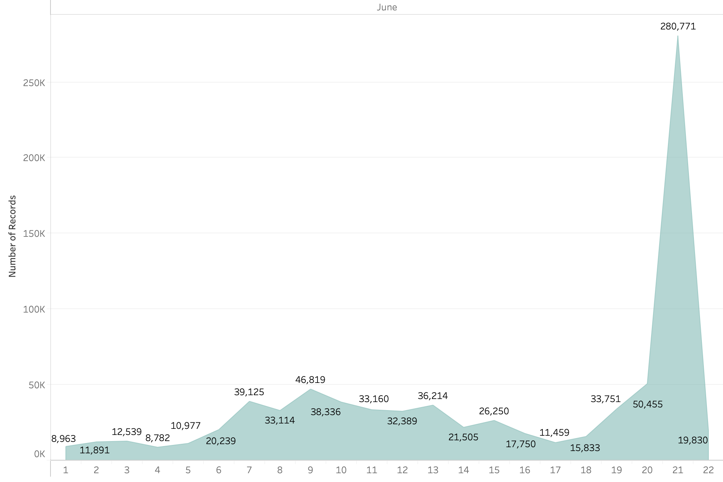
Exploratory data analysis Number of tweets (June)

Slide 4
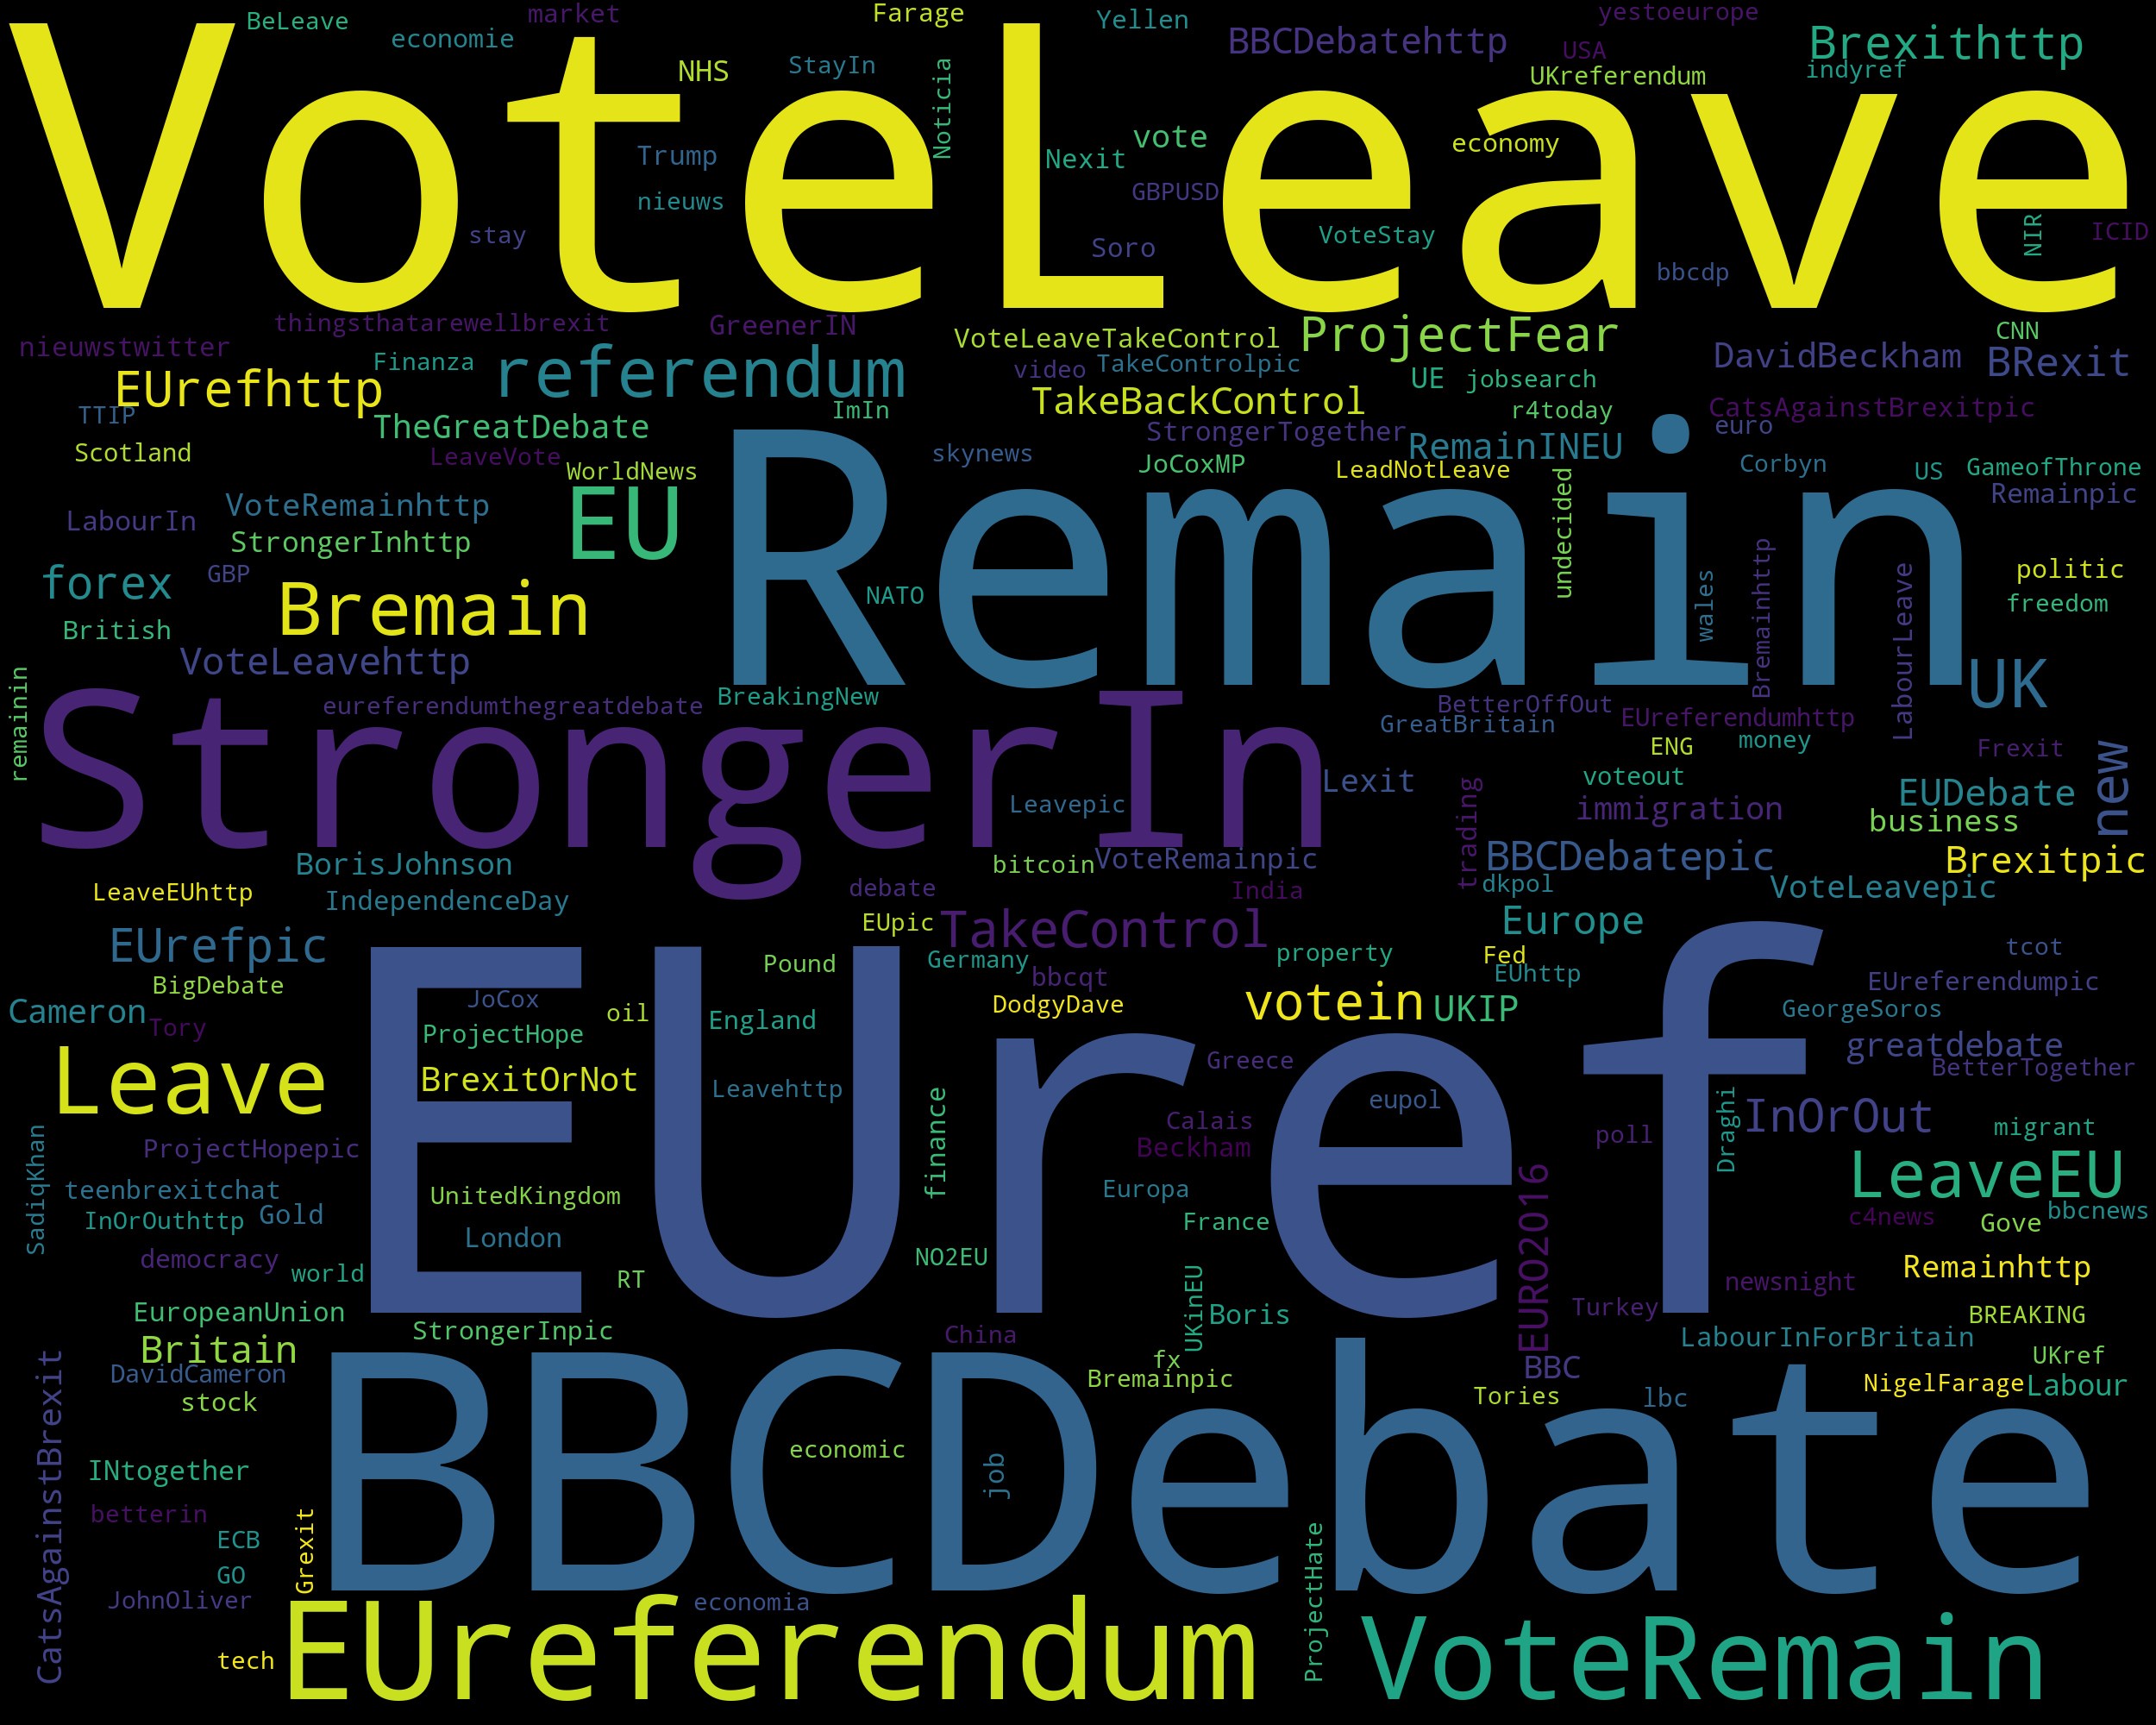
Exploratory data analysis Most common hashtags (#)

Slide 5
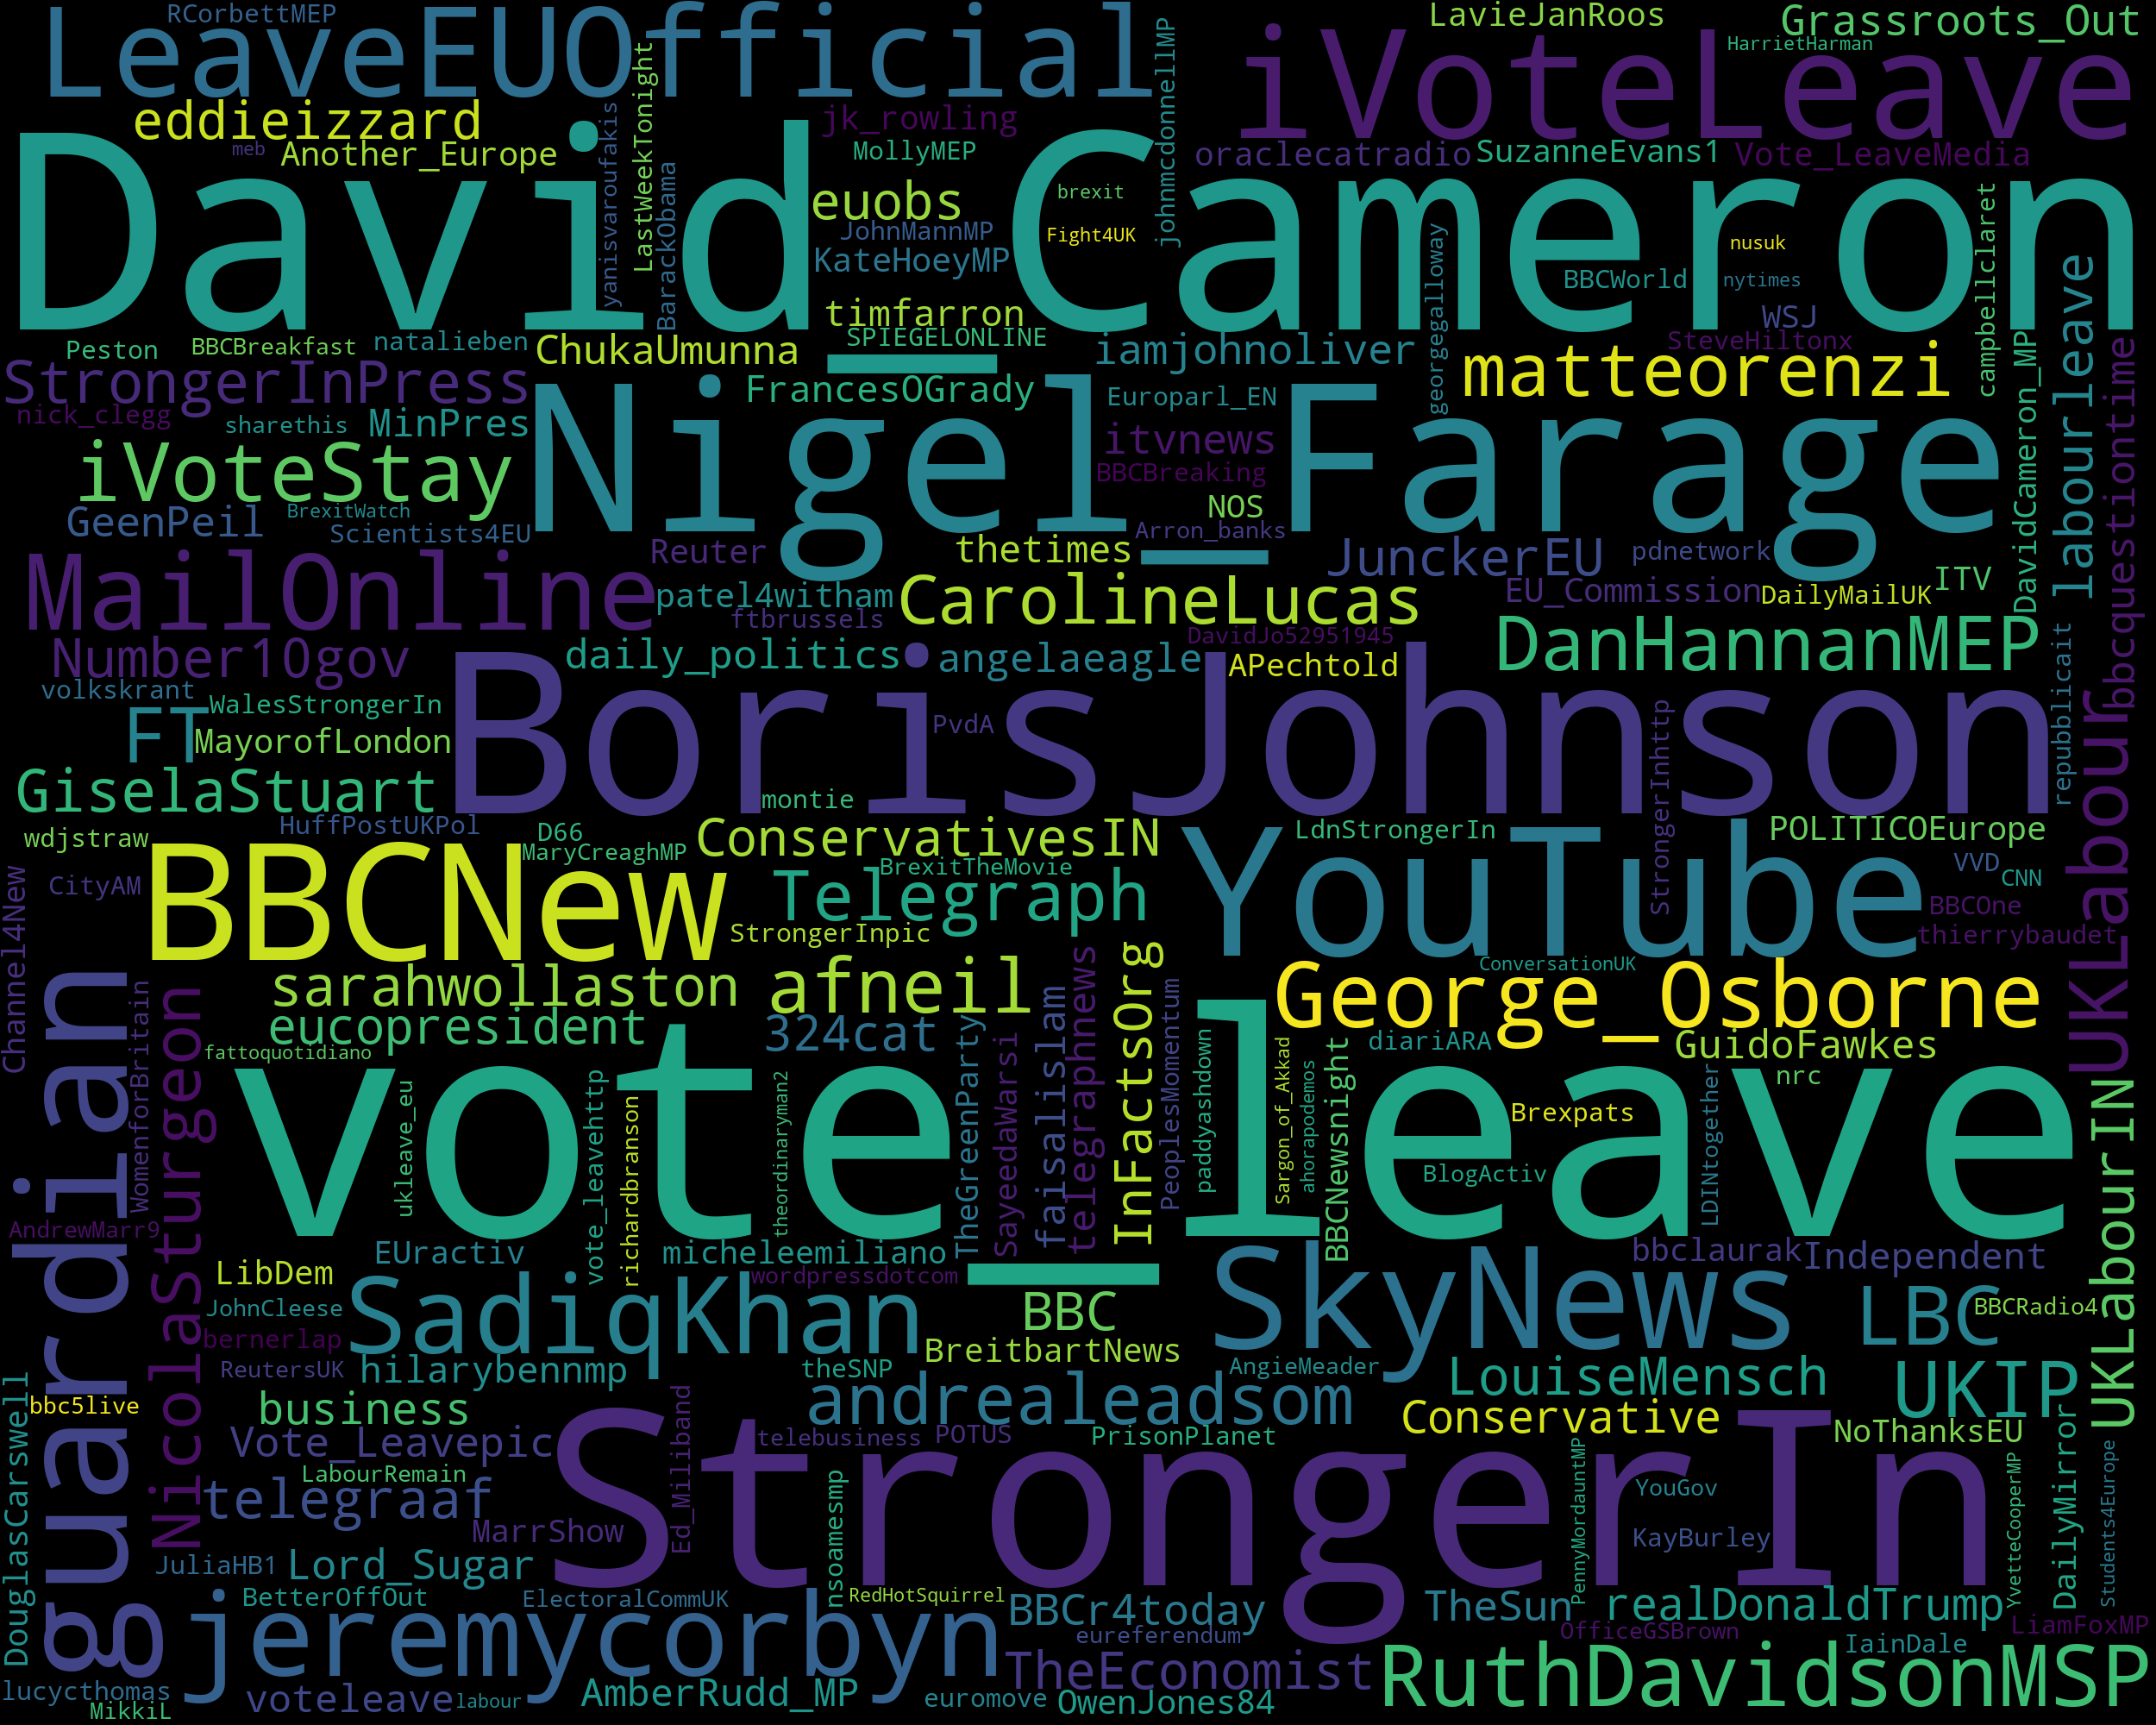
Exploratory data analysis Most common Mentions (@)

Slide 6
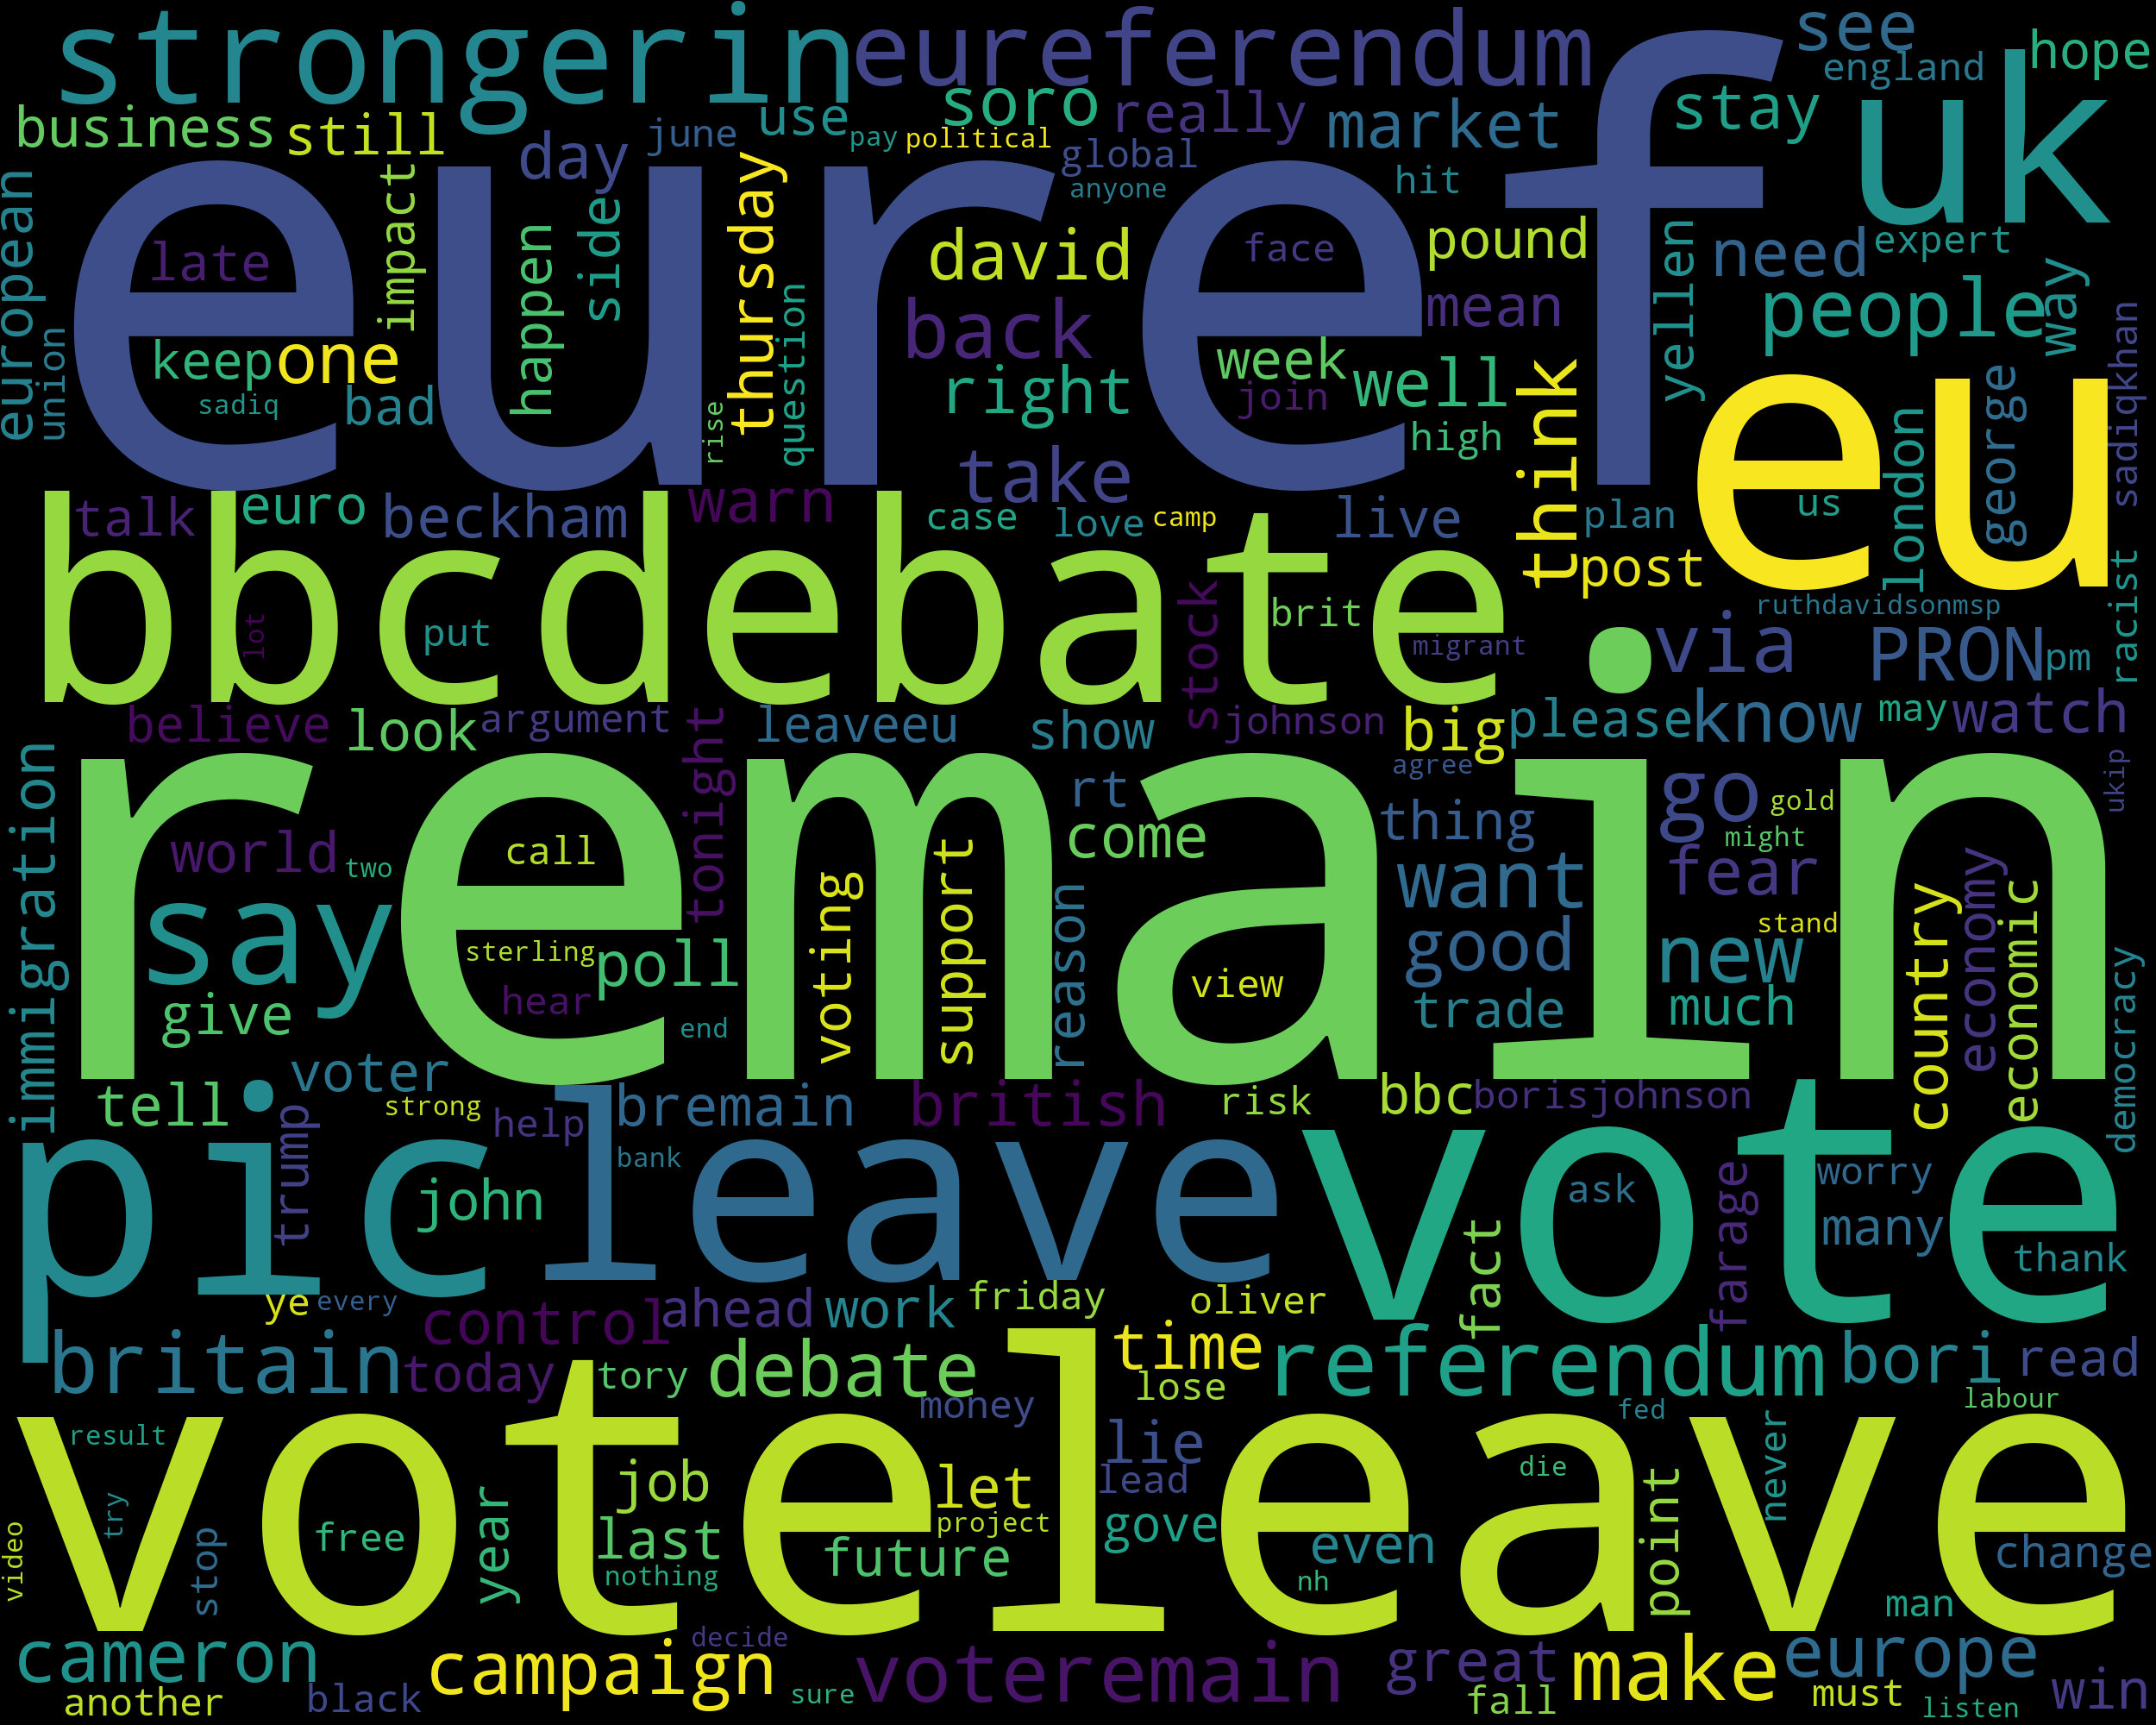
Exploratory data analysis Most common words

Slide 7
Step 1: Pre-processing Test and training data
Training Dataset has 100,000 tweets, (used 10,000)
Made tweets lowercase
Removed URLs (http:// …)
Removed special characters and numbers
Removed single characters in the tweets
Replaced multiple space character with one space
Removed stop-words
Target data: Non-English tweets

Slide 8
Step 2 -4 : Tokenization/ Lemmatization/ vectorization
.split()
Used spacy for lemmatization, nlp.pipe() with batch_size = 20 for efficiency
TF-IDF vectorizer (option to do lemmatization and remove stop-words within this step)
Training data
X = vectorized tweets
y = sentiment labels - positive (1) and negative (0)

Slide 9
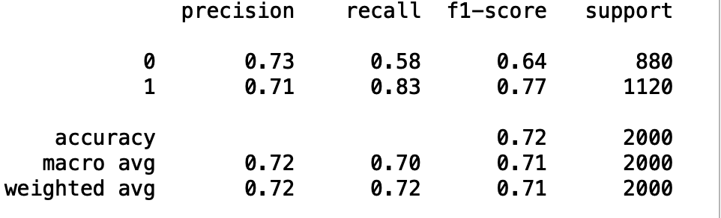
Step 3-6: DIMENSION REDUCTION/ TRAIN MODEL/ Test
Model 1 Random Forest Classifier (n_estimators = 200)
Train-test-split 80% train, 20% test (72.0% accuracy)
Confusion matrix, F-score, accuracy
Cross validation (cv = 5) (72.5% accuracy)

Slide 10
Step 3-6: DIMENSION REDUCTION/ TRAIN MODEL/ Test
Model 2 Random Forest with PCA dimension reduction and grid search
best = 60.9% accuracy, opt_params = max_depth 20, max_features 'auto’, n_estimators ‘100’
PCA for dimension reduction (Target variance 95%) (91 components, EVR of 0.138)
cv = 5
﻿param_grid = {'max_features': ['auto', 'sqrt’],
'max_depth': [1, 2, 5, 10, 20],
'n_estimators': [100, 200, 500],
'random_state': [0]}
Model 3 Support Vector Machine with PCA dimension reduction and grid search
best = 69.8%, opt_params C=10, gamma=1
cv =5
‘rbf’ kernel
PCA for dimension reduction (Target variance 95%) (91 components, EVR of 0.138)

Slide 11
Finally, classification
Used to Model 1 to predict the whole target dataset
Note: using positive and negative words in tweets about Brexit, since dataset is not trained on a dataset related to Brexit/ British politics, limitations for areas like sarcasm
Model 1: ﻿24998 labelled negative and 166346 labelled positive (13% negative, 87% positive)
Model 3: ﻿16245 labelled negative and 175099 labelled positive (8.5% negative, 91.5% positive)
Possible explanations?

Slide 12
REFLECTIONS
Start to end project, from knowing nothing about Python
Kaggle competition twitter sentiment (79% top score)
Gathering data was the main issue, could not specify the type of data received
Dealing with large datasets
Useful to go further
Different models, increasing accuracy (BERT, Naïve Bayes)
More/ varied data (historical tweets from key dates in the Brexit saga, timeseries for change in sentiment percentage throughout the month or year)
Webscraping Twitter API, ensuring data quality (more Brexit events in the future)
Positive/ negative dictionaries – sentiment scoring

